Slide 1
What is React

Slide 2
What is React?
Open source front end JavaScript library for building component based applications
Created by Facebook in 2013
React project uses:
HTML, CSS, JavaScript
or
HTML, CSS , TypeScript
Uses a Virtual DOM to optimize browser performance
Official Website: https://reactjs.org

Slide 3
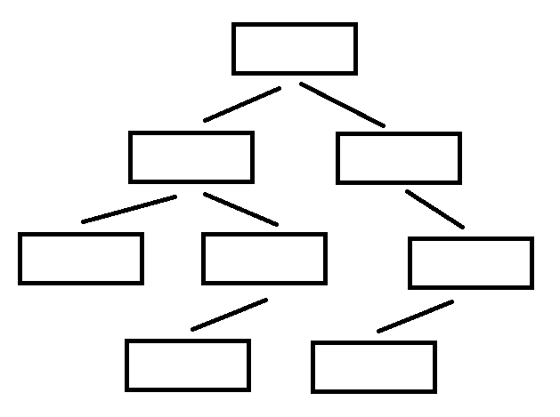
Real DOM vs. Virtual DOM
Real DOM

Slide 4
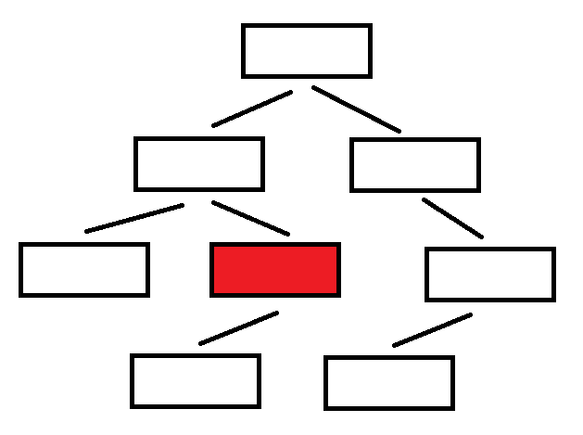
Real DOM vs. Virtual DOM
Real DOM

Slide 5
Real DOM vs. Virtual DOM
Virtual DOM
Real DOM

Slide 6
Real DOM vs. Virtual DOM
Virtual DOM
Real DOM

Slide 7
Real DOM vs. Virtual DOM
Virtual DOM
Real DOM
Updates

Slide 8
What are Components
A component is a piece of UI
Dealing with specific functionality or appearance
Can be reuse across our application

Slide 9
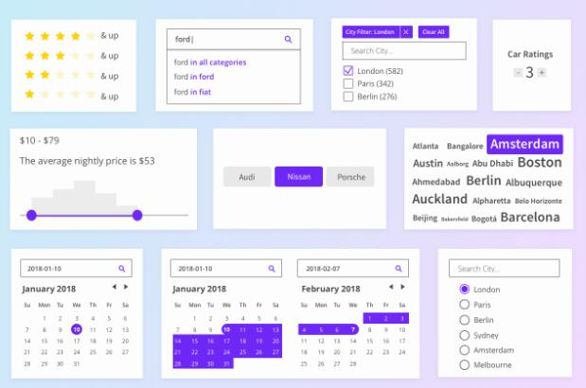
What are Components

